Slide 1


CHAPTER 5:
Advanced React Hooks

Slide 2

Outline
useContext Hook
useRef Hook
useReducer Hook
useCallback Hook
useMemo Hook
Custom Hooks

Slide 3
useContext
Notes:
Real-Life Example: Theme Context
A theme setting is needed by the navbar, layout, buttons, cards, and settings page. Passing it through every component is bad design.
import { createContext, useContext, useMemo, useState } from "react";
const ThemeContext = createContext(null);
export function ThemeProvider({ children }) {
const [theme, setTheme] = useState("light");
const value = useMemo(() => {
return {
theme,
isDark: theme === "dark",
toggleTheme() {
setTheme((current) => (current === "dark" ? "light" : "dark"));
},
};
}, [theme]);
return (
<ThemeContext.Provider value={value}>
{children}
</ThemeContext.Provider>
);
}
export function useTheme() {
const context = useContext(ThemeContext);
if (!context) {
throw new Error("useTheme must be used inside ThemeProvider");
}
return context;
}
Now any component can use:
function ThemeToggle() {
const { theme, toggleTheme } = useTheme();
return (
<button onClick={toggleTheme}>
Current theme: {theme}
</button>
);
}

Slide 4
React useContext Hook
React Context is a way to manage state globally.
It can be used together with the useState Hook to share state between deeply nested components more easily than with useState alone.
The Problem:
State should be held by the highest parent component in the stack that requires access to the state.
To illustrate, we have many nested components. The component at the top and bottom of the stack need access to the state.
To do this without Context, we will need to pass the state as "props" through each nested component. This is called "prop drilling".

Slide 5
Prop drilling
Prop drilling happens when data is passed through many components that do not need it, only because a deeply nested child needs access.

Slide 6
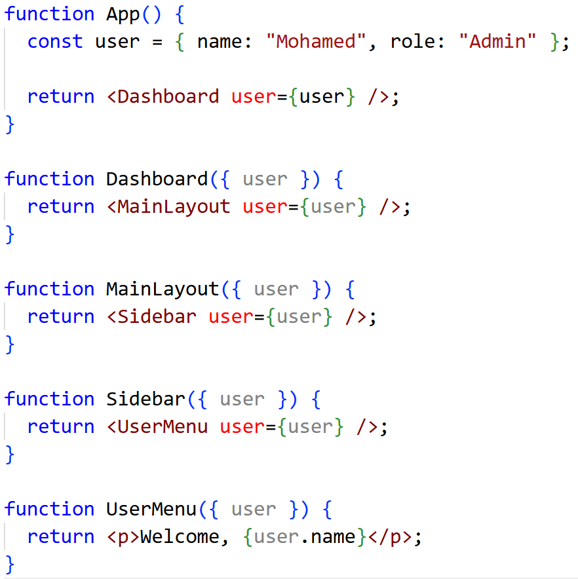
Example without context
Dashboard, MainLayout, and Sidebar do not use the user, but they are forced to pass it down. This creates unnecessary coupling.
Real-world problem: prop drilling becomes painful in applications with authentication, themes, permissions, language settings, shopping carts, or tenant/company settings.

Slide 7
useContext
useContext solves this problem by providing a more elegant solution for passing data down the component tree.
It allows components to consume values from a React context without the need to explicitly pass props through every level of the component hierarchy.
This makes the code cleaner, more readable, and easier to maintain.
Context is useful when many components need the same data.

Slide 8
Basic workflow of using useContext in React
Import createContext and useContext.
Create a context.
Wrap components with Context.Provider.
Pass data using the value prop.
Read the data using useContext(ContextName).

Slide 9
Creating the Context
To create context, you must Import createContext and initialize it:
import { createContext, useContext } from "react";
const UserContext = createContext(null);

Slide 10
Context Provider
A context provider in React is a component that provides a context value to its descendants in the component tree.
It is part of React's Context API, which is designed for managing global state or sharing data across the component tree without having to pass props down manually at every level.
By using context providers, you can easily share data or state across multiple components in your React application, reducing the need for prop drilling and making your code more concise and maintainable.

Slide 11
Context Provider
Wrap child components in the Context Provider and supply the state value.
function App() {
const [user, setUser] = useState("Mohamed Ahmed");
return (
<UserContext.Provider value={user}>
<h1>Hello {user}!</h1>
<User />
</UserContext.Provider>
);
}

Slide 12
Use the useContext Hook
Now, all components in this tree will have access to the user Context.
To use the Context in a child component, we need to access it using the useContext Hook.
First, include the useContext in the import statement:
import { createContext, useContext, useState } from "react";
function User() {
const user = useContext(UserContext);
return (
<div>
<h1>User Component</h1>
<h2>Hello {user} again!</h2>
</div>
);
}

Slide 13
useRef

Slide 14
React useRef Hook
The useRef Hook allows you to persist values between renders.
It can be used to store a mutable value that does not cause a re-render when updated.
It can be used to access a DOM element directly.
Does Not Cause Re-renders
If we tried to count how many times our application renders using the useState Hook, we would be caught in an infinite loop since this Hook itself causes a re-render.
To avoid this, we can use the useRef Hook.

Slide 15
Basic syntax
const refName = useRef(initialValue);
useRef() only returns one item. It returns an Object called current.
{
current: initialValue
}
When we initialize useRef we set the initial value: useRef(0).
It's like doing this: const count = {current: 0}.
We can access the count by using count.current.
Changing ref.current does not trigger a re-render.

Slide 16
useRef hook use cases in React applications
It is mainly used for:
Accessing DOM elements directly.
Persisting values between renders.
Storing mutable data without triggering UI updates.
Key distinction: use state when the UI should update. Use ref when you need to remember something but changing it should not update the UI.

Slide 17
1. Accessing DOM elements:
One common use case for useRef is to access and interact with DOM elements directly.
You can use useRef to create a reference to a DOM element and then access properties or call methods on that element.
To create ref, you must Import useRef from react:
import { useRef } from "react";

Slide 18
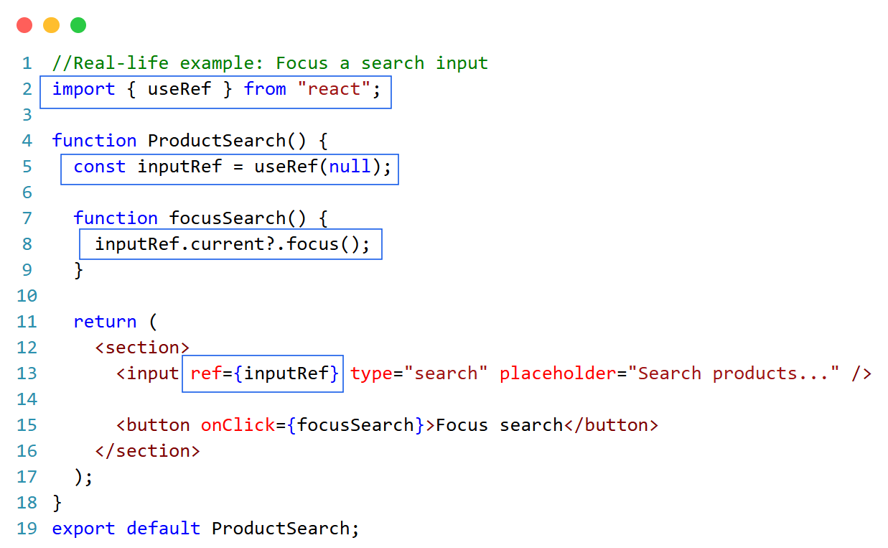
This is useful in:
Search bars
Login forms
Modal dialogs
Chat input boxes
OTP inputs
Admin dashboards

Slide 19
2. Storing mutable values
You can use useRef to store mutable values that you want to persist between renders.
These values can be updated directly without causing re-renders.

Slide 20
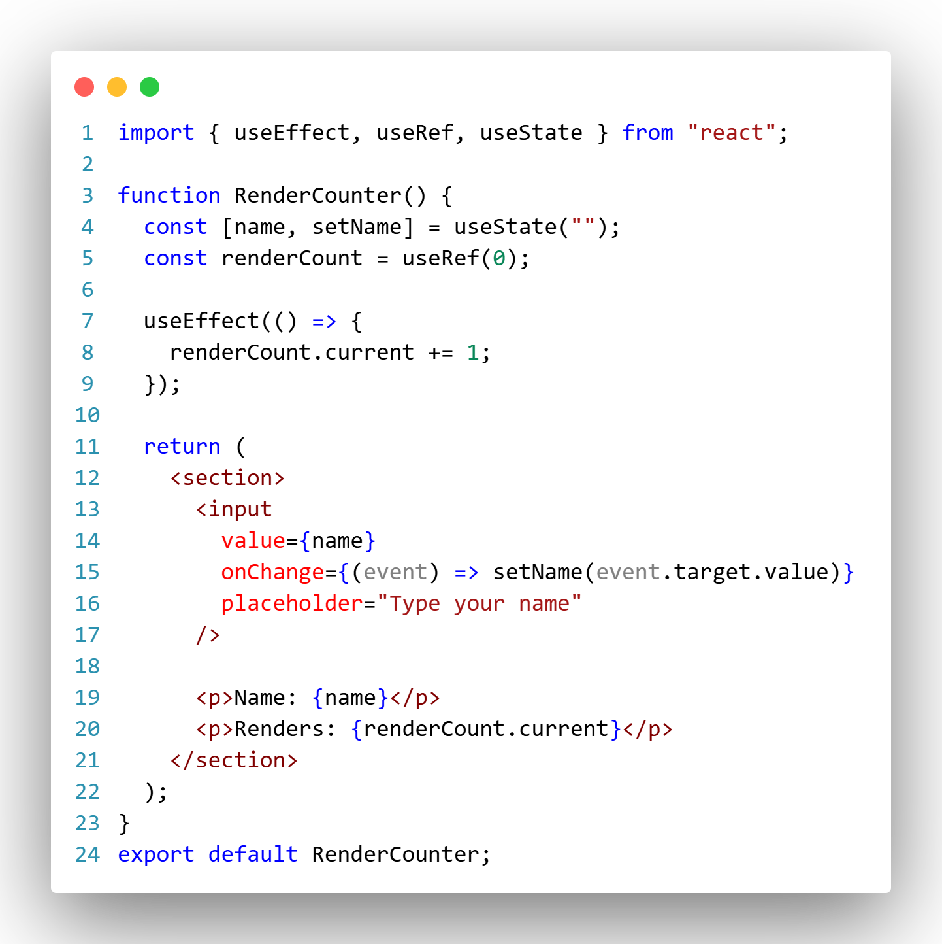
Example: Count renders without causing re-render
This works because the render count is not part of the visual state that should drive rendering.

Slide 21
useReducer
Notes:
Real-Life Example: Shopping Cart Reducer
A shopping cart has coordinated state transitions:
Add item
Remove item
Increase quantity
Decrease quantity
Clear cart
Apply coupon
This is better handled with a reducer.
const initialCartState = {
items: [],
coupon: null,
};
function cartReducer(state, action) {
switch (action.type) {
case "add_item": {
const existingItem = state.items.find(
(item) => item.id === action.product.id
);
if (existingItem) {
return {
...state,
items: state.items.map((item) =>
item.id === action.product.id
? { ...item, quantity: item.quantity + 1 }
: item
),
};
}
return {
...state,
items: [
...state.items,
{ ...action.product, quantity: 1 },
],
};
}
case "remove_item":
return {
...state,
items: state.items.filter((item) => item.id !== action.productId),
};
case "increase_quantity":
return {
...state,
items: state.items.map((item) =>
item.id === action.productId
? { ...item, quantity: item.quantity + 1 }
: item
),
};
case "decrease_quantity":
return {
...state,
items: state.items
.map((item) =>
item.id === action.productId
? { ...item, quantity: item.quantity - 1 }
: item
)
.filter((item) => item.quantity > 0),
};
case "apply_coupon":
return {
...state,
coupon: action.coupon,
};
case "clear_cart":
return initialCartState;
default:
throw new Error(`Unknown cart action: ${action.type}`);
}
}
Cart component
import { useMemo, useReducer } from "react";
function ShoppingCart() {
const [cart, dispatch] = useReducer(cartReducer, initialCartState);
const subtotal = useMemo(() => {
return cart.items.reduce((total, item) => {
return total + item.price * item.quantity;
}, 0);
}, [cart.items]);
const discount = cart.coupon?.type === "percent"
? subtotal * cart.coupon.value
: 0;
const total = subtotal - discount;
return (
<section>
<h2>Shopping Cart</h2>
{cart.items.map((item) => (
<article key={item.id}>
<strong>{item.name}</strong>
<span>Qty: {item.quantity}</span>
<button
onClick={() =>
dispatch({ type: "decrease_quantity", productId: item.id })
}
>
-
</button>
<button
onClick={() =>
dispatch({ type: "increase_quantity", productId: item.id })
}
>
+
</button>
</article>
))}
<p>Subtotal: ${subtotal.toFixed(2)}</p>
<p>Total: ${total.toFixed(2)}</p>
<button onClick={() => dispatch({ type: "clear_cart" })}>
Clear cart
</button>
</section>
);
}

Slide 22
React useReducer Hook
The useReducer Hook is similar to the useState Hook. It allows for custom state logic.
If you find yourself keeping track of multiple pieces of state that rely on complex logic, useReducer may be useful.
Syntax:
The useReducer Hook accepts two arguments:
useReducer(<reducer>, <initialState>)
The reducer function contains your custom state logic and the initialState can be a simple value but generally will contain an object.
The useReducer Hook returns the current state and a dispatch method.
The useReducer hook in React is used to manage complex state logic in functional components. It's an alternative to useState that allows you to update the state based on the previous state and an action.

Slide 23
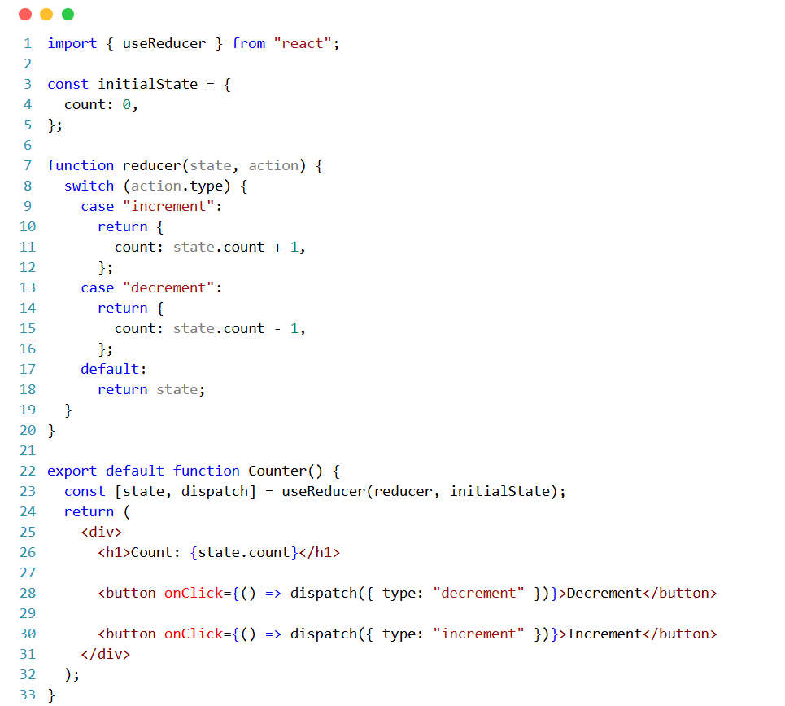
React useReducer Hook Example

Slide 24
Cont…
In the above example:
We defined a reducer function (reducer) that takes the current state and an action as parameters and returns the new state based on the action.
We created a component (Counter) that initializes its state using useReducer.
The initial state is an object with a count property set to 0.
Inside the component, we rendered the current count value from the state and two buttons to increment and decrement the count. When a button is clicked, it dispatches an action to the reducer.
The reducer updates the state based on the action type and returns the new state. React then updates the component with the new state, causing it to re-render.

Slide 25
When to Choose useReducer Instead of useState
Use useState when:
State is simple.
Updates are independent.
The next state is easy to calculate.
Use useReducer when:
State has multiple fields.
State transitions depend on action types.
Updates must be predictable.
Business rules are growing.
Several event handlers update the same state in different ways.
You want reducer logic outside the component for testing.

Slide 26
useCallback
Notes:
Real-Life Example: Memoized Child Component
import { memo, useCallback, useState } from "react";
const ProductCard = memo(function ProductCard({ product, onAddToCart }) {
console.log("Rendering product:", product.name);
return (
<article>
<h3>{product.name}</h3>
<p>${product.price}</p>
<button onClick={() => onAddToCart(product.id)}>
Add to cart
</button>
</article>
);
});
function ProductList({ products }) {
const [cartIds, setCartIds] = useState([]);
const handleAddToCart = useCallback((productId) => {
setCartIds((ids) => [...ids, productId]);
}, []);
return (
<section>
<p>Cart items: {cartIds.length}</p>
{products.map((product) => (
<ProductCard
key={product.id}
product={product}
onAddToCart={handleAddToCart}
/>
))}
</section>
);
}

Slide 27
React useCallback Hook
useCallback is a React hook that allows you to memoize a callback function.
It returns a memoized version of the callback function that only changes if one of the dependencies has changed. This can be useful for optimizing performance by preventing unnecessary re-renders or re-computations.
The React useCallback Hook returns a memoized callback function.
Memoization
The term “memoization” comes from the Latin word “memorandum” (“to remember”), which is commonly shortened to “memo” , and which means “to transform the results of a function into something to remember.”.
Think of memoization as caching a value so that it does not need to be recalculated.

Slide 28
React useCallback Hook
Here's how you use useCallback:
Import the hook: First, make sure to import useCallback from React.
Use the hook: useCallback takes two arguments:
The first argument is the function you want to memoize.
The second argument is an array of dependencies. If any value in this array changes, the function will be re-created.
Using the memoized function: You can use the memoized function just like a regular function. The benefit is that the function will only be re-created if the dependencies change, potentially improving performance by avoiding unnecessary re-creations of the function.

Slide 29
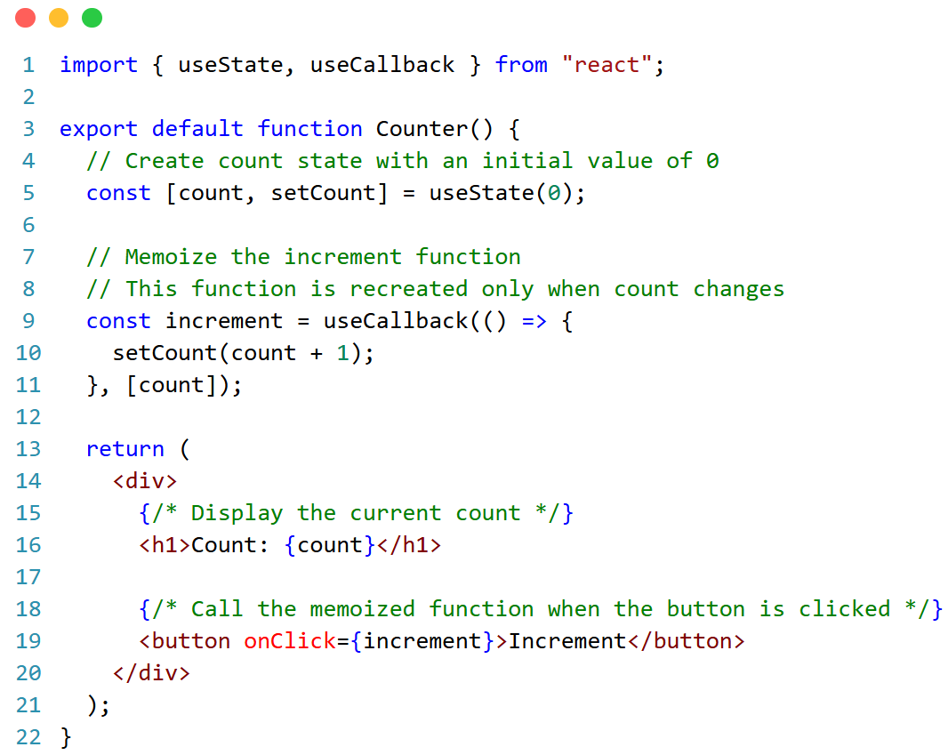
Example

Slide 30
Cont….
In the previous example:
We used useCallback to memoize the increment function, which updates the count state. The function is re-created only when the count dependency changes.
This optimization helps prevent unnecessary re-renders caused by creating a new instance of the increment function on each render.
The function is used in the button's onClick handler to increment the count.
By using useCallback, you can optimize your component's performance by reducing the number of times a function is recreated, especially if the function is passed as a prop to child components or used in useEffect dependencies.

Slide 31
useMemo

Slide 32
React useMemo Hook
useMemo is a React Hook that helps improve performance by memoizing (caching) expensive computations.
Memoization means storing the result of a function call and reusing it when the function's inputs (dependencies) haven't changed.
Think of memoization as caching a value so that it does not need to be recalculated.
The useMemo Hook only runs when one of its dependencies update. This can improve performance.
The useMemo and useCallback Hooks are similar. The main difference is that useMemo returns a memoized value and useCallback returns a memoized function.
const cachedValue = useMemo(calculateValue, dependencies);
Notes:
Real-Life Example: Filtering a Large Product List
import { useMemo, useState } from "react";
function ProductTable({ products }) {
const [query, setQuery] = useState("");
const [category, setCategory] = useState("all");
const [sortBy, setSortBy] = useState("price");
const visibleProducts = useMemo(() => {
let result = products;
if (query.trim()) {
const normalizedQuery = query.toLowerCase();
result = result.filter((product) =>
product.name.toLowerCase().includes(normalizedQuery)
);
}
if (category !== "all") {
result = result.filter((product) => product.category === category);
}
return [...result].sort((a, b) => {
if (sortBy === "price") return a.price - b.price;
if (sortBy === "rating") return b.rating - a.rating;
return a.name.localeCompare(b.name);
});
}, [products, query, category, sortBy]);
return (
<section>
<input
value={query}
onChange={(event) => setQuery(event.target.value)}
placeholder="Search products..."
/>
<select
value={category}
onChange={(event) => setCategory(event.target.value)}
>
<option value="all">All</option>
<option value="laptops">Laptops</option>
<option value="phones">Phones</option>
</select>
<select
value={sortBy}
onChange={(event) => setSortBy(event.target.value)}
>
<option value="price">Price</option>
<option value="rating">Rating</option>
<option value="name">Name</option>
</select>
<p>{visibleProducts.length} products found</p>
<ul>
{visibleProducts.map((product) => (
<li key={product.id}>
{product.name} — ${product.price}
</li>
))}
</ul>
</section>
);
}

Slide 33
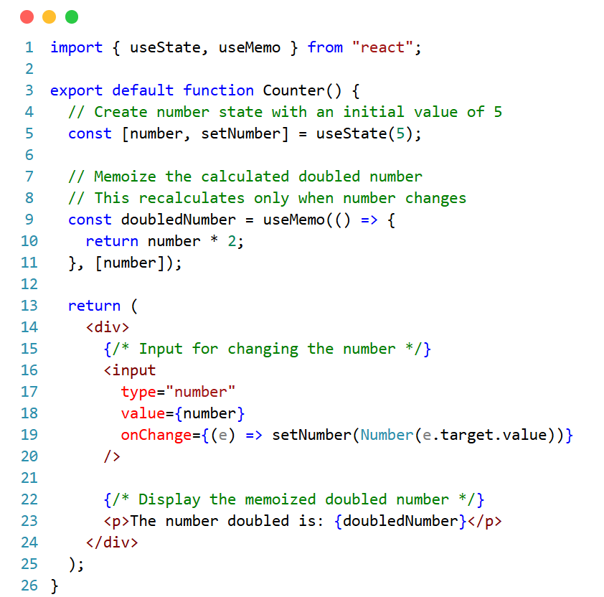
React useMemo Hook

Slide 34
React useMemo Hook
We defined a state variable number with an initial value of 5.
We created a doubledNumber constant using useMemo.
Inside useMemo, we multiplied the number by 2.
Crucially, we specify [number] as the dependency array. This tells useMemo to only recalculate doubledNumber when number changes.
In the component's return statement, we display both the original number and the doubledNumber.
Benefit:
When you type a new value in the input, only the number state updates. The multiplication using useMemo only happens when number changes, resulting in smoother performance.

Slide 35
React useMemo Hook
Hook | Returns | Use case
useMemo | A memoized value | Cache expensive calculation result
useCallback | A memoized function | Keep function reference stable

Slide 36
Custom Hooks
Notes:
Real-Life Custom Hook: useOnlineStatus
import { useEffect, useState } from "react";
export function useOnlineStatus() {
const [isOnline, setIsOnline] = useState(navigator.onLine);
useEffect(() => {
function handleOnline() {
setIsOnline(true);
}
function handleOffline() {
setIsOnline(false);
}
window.addEventListener("online", handleOnline);
window.addEventListener("offline", handleOffline);
return () => {
window.removeEventListener("online", handleOnline);
window.removeEventListener("offline", handleOffline);
};
}, []);
return isOnline;
}
Usage
function NetworkBanner() {
const isOnline = useOnlineStatus();
if (isOnline) return null;
return (
<div role="alert">
You are offline. Some changes may not sync.
</div>
);
}

Slide 37
React Custom Hooks
Custom hooks in React are reusable functions that encapsulate logic and stateful behavior that can be shared across different components.
They follow the same rules as regular hooks, such as only being called at the top level of a function component or another custom hook and only being called from React function components or other hooks.
Creating a Custom Hook:
Define the hook: Create a function with the desired logic and name it following the convention of starting with "use" (e.g., useFetch, useCounter, useTheme).
Add the logic: Inside the hook function, include the state, effects, and any other logic you want to encapsulate.
Return the values: Return any values or state from the hook so they can be used in other components.
Notes:
Real-Life Custom Hook: useLocalStorage
Many applications need to persist settings such as theme, sidebar state, language, or draft input.
import { useCallback, useState } from "react";
export function useLocalStorage(key, initialValue) {
const [value, setValue] = useState(() => {
try {
const storedValue = window.localStorage.getItem(key);
return storedValue ? JSON.parse(storedValue) : initialValue;
} catch {
return initialValue;
}
});
const updateValue = useCallback(
(nextValue) => {
setValue((currentValue) => {
const resolvedValue =
typeof nextValue === "function"
? nextValue(currentValue)
: nextValue;
window.localStorage.setItem(key, JSON.stringify(resolvedValue));
return resolvedValue;
});
},
[key]
);
return [value, updateValue];
}
Usage
function SettingsPanel() {
const [theme, setTheme] = useLocalStorage("theme", "light");
return (
<section>
<p>Theme: {theme}</p>
<button
onClick={() =>
setTheme((current) => current === "dark" ? "light" : "dark")
}
>
Toggle theme
</button>
</section>
);
}

Slide 38
React Custom Hooks
In a counter application, you can create a custom hook to manage the counter's state and logic.
The custom hook will handle the state for the counter value and provide functions to increment and decrement the counter.
This hook can then be used in a component that displays the counter and buttons for controlling it.
Here's an example of how you can create a custom hook for the counter and use it in a React component:

Slide 39
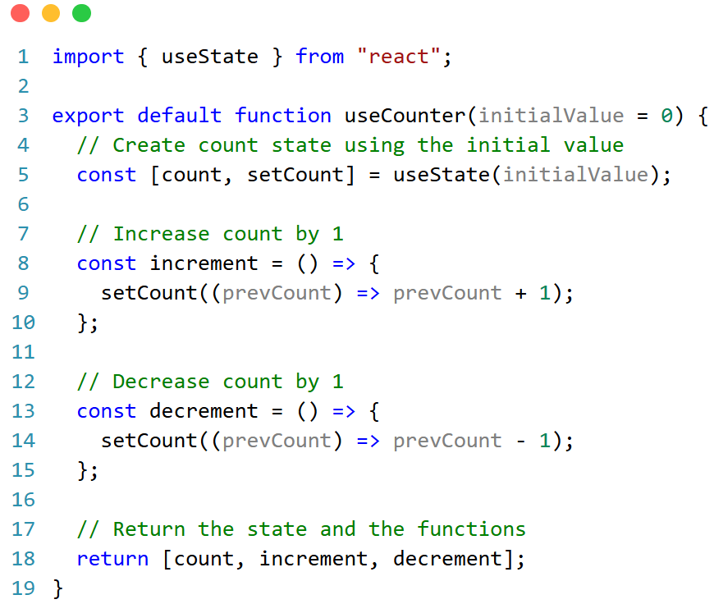
React Custom Hooks Example
Step 1: Create the Custom Hook (useCounter.js)
First, create a file named useCounter.jsx in the hooks folder of your project. In this file, define the custom hook useCounter:

Slide 40
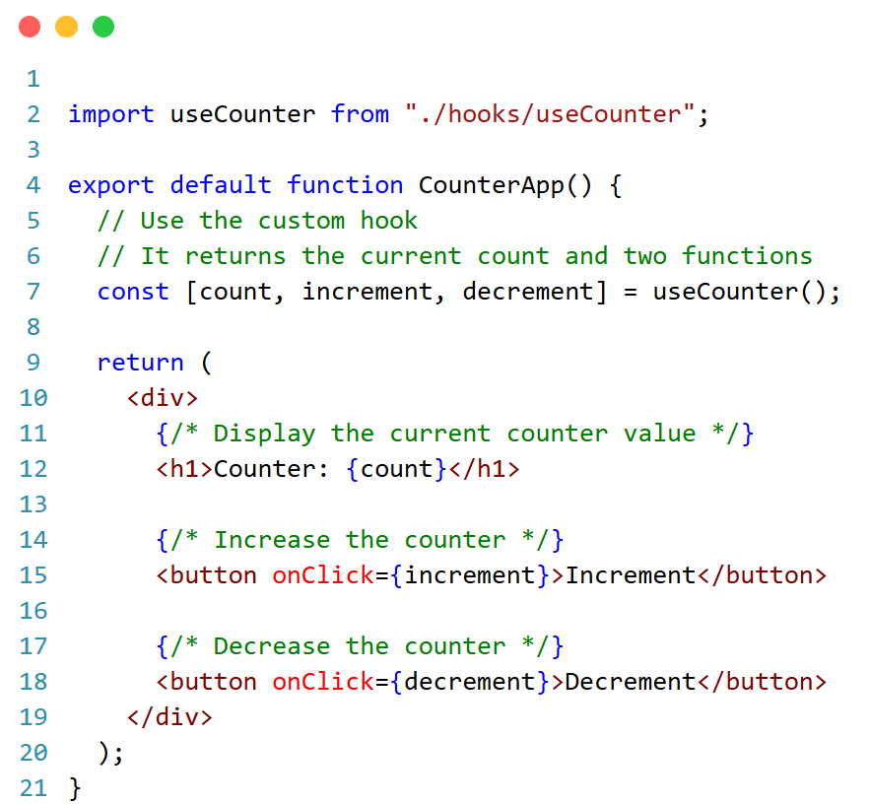
React Custom Hooks Example
Step 2: Use the Custom Hook in a Component (CounterApp)
Next, create a component named CounterApp and use the useCounter custom hook in it:

Slide 41
Chapter Summary
Hook / API | Main purpose | Best real-world use
useContext | Read shared data from context | Auth, theme, locale, permissions
useRef | Persist mutable value without re-render | DOM access, timers, previous values
useReducer | Manage complex state transitions | Cart, forms, task managers, wizards
useCallback | Cache function reference | Memoized children, hook dependencies
useMemo | Cache calculated value | Expensive filtering/sorting/derived data
Custom Hooks | Reuse stateful logic | Forms, storage, network status, data flows

Slide 42
END

